Slide 1
COMING SOON
Ma poi sono le mie, perché le stai guardando? Fatti le slide tue

Slide 2
SERVER FEATURES
Certificate server

Slide 3
GENERAL PROGRAMMING TECHNIQUES

Slide 4
No hardcoded password
Harcoding password in code

Slide 5
SQL Injection Prevention
Injection is included by OWASP in its Top 10 Web Application Security Risk list
Injections happens when user input is not filtered or validated
Database queries are run using PreparedStatements, that use placeholder before data evaluation, so query code and parameters are not mixed.
Even if this countermeasure shouldn’t work, there are some sensitive queries with «LIMIT 1» constraint: that means that even if some data can be disclosed, attacker should retrieve them one at a time (and provide different inputs for every attack)

Slide 6
Password Management

Slide 7
Password Management Introduction
Password management is critical for system security
Storing them in plain text or using weak unsalted hashes leads to account stealing, which may be the first step to sensitive data disclosure or backdoor installation
An example of weak hash is MD5 that should be used only for digests, because is a fast, memory-conserving algorithm, crackable by GPUs, FPGAs and ASICs
Allowing easily-guessable password like «1234» or «password» is a vulnerability independent from hashing technique, so a strong password policy should be enforced.
A system should be resilient even to password stealing, for example implementing a multifactor authentication.

Slide 8
Password cryptography
We analyzed several password cryptography techniques, like using not only a salt, but a pepper too
A pepper is like salt but is not stored alongside the password.
Even though may seem to add security to passwords, no algorithm supports them, meaning that we would have to develop our cryptography algorithm and would probably reduce rather than enhance system security
Among all hashing algorithms, we whittled it down to the ones designed to passwords: bcrypt, scrypt and PBDKF2.
New ones are being developed, like Argon2, but security administrator should not use too recent algorithms because there could be critcial weaknesses not known yet.

Slide 9
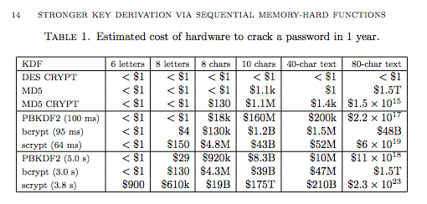
We decided to use bcrypt because it works using a table thats is modified after every access, which makes GPUs ineffective in cracking it (unlike PBKDF2)
While scrypt should provide better security, it is a relatively recent algorithm (2009), meaning that has not received enough scrutiny. Most recent feedback has downsized its reputation and its encryption is by far more computationally intensive. Moreover scrypt is designed for password based hard disk encryption, not password encryption.
bcrypt needs more expensive hardware than PBDKF2 in order to crack it only if password is less than 55 characters long, that’s bcrypt text length limit. Because a password is usually much shorter than 55 characters, that should not be an issue.

Slide 10
2-steps Authentication
We implemented a 2-steps authentication system, so an attacker can’t steal user identity by password knowledge only.
We used IP as identifier, but in a real-world scenario a more accurate device fingerprint would be needed.
For every successful login attempt the devices is compared to a list of trusted ones: if it’s one of them, login request is approved; otherwise a confirmation mail is sent.
Those codes are not stored in plain text, but hashed with SHA-256
Codes expire after 30 minutes. No new codes can be required for same (user,device) before expiration.
After issuing a new code, old one is deleted (attacker can’t lead a replay attack with an old code)
This way an attacker could steal an account only if:
Knows passwords and has one of the trusted devices
Or knows password and stole email account

Slide 11
Authentication

Slide 12
Authentication

Slide 13
SID : Simple Intrusion Detector

Slide 14
Final thoughts

Slide 15
Implicit weaknesses

